Slide 1

Hash Tables
Prof. Zhenyu He
Harbin Institute of Technology, Shenzhen

Slide 2

Outline
Dynamic Sets
Hash Tables
Direct-access tables
Resolving collisions by chaining
Choosing hash functions
Open addressing

Slide 3

Dynamic Sets

Slide 4
Dynamic Sets
Structures for dynamic sets
Elements have a key and satellite data
Dynamic sets may support queries such as:
Search(S, k), Minimum(S), Maximum(S), Successor(S, x), Predecessor(S, x)
They may also support modifying operations like:
Insert(S, x), Delete(S, x)

Slide 5
Hash Tables

Slide 6
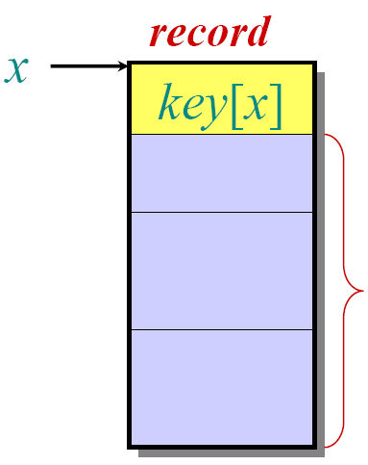
Symbol-table problem
Symbol table S holding n records:
record
Operations on S:
• INSERT (S, x)
• DELETE (S, x)
• SEARCH (S, k)
key
Other fields
containing
satellite data
How should the data structure S be organized?

Slide 7
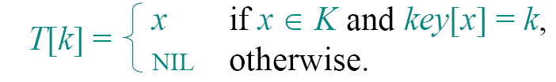
Direct-access table
IDEA: Suppose that the keys are drawn from
the set U⊆{0, 1, …, m–1}, and keys are
distinct. Set up an array T[0 . .m–1]:
if
and
otherwise.
Then, operations take Θ(1) time.

Slide 8
Direct-access table
Problem:
1. The range of keys can be large:
‧64-bit numbers (which represent
18,446,744,073,709,551,616different keys),
‧character strings (even larger!).
2. The set K of keys actually stored maybe << U,
Most of the space allocated for T is wasted.

Slide 9
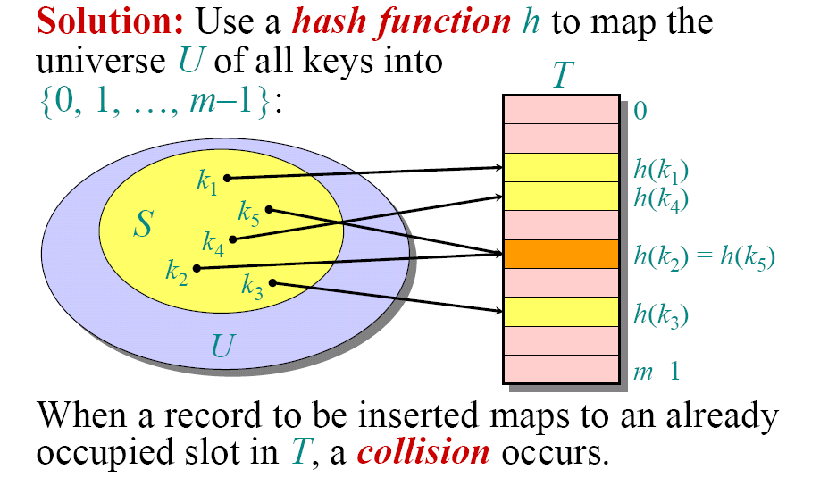
Hash Tables
Solution: Use a hash function h to map the
universe U of all keys into
{0, 1, …, m–1} :
When a record to be inserted maps to an already
occupied slot in T, a collision occurs.

Slide 10
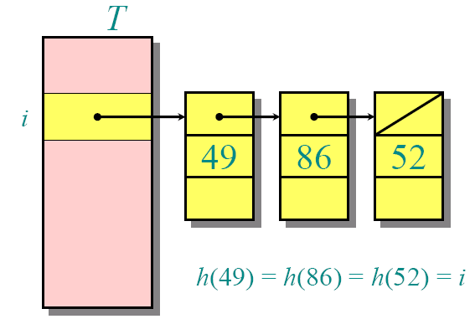
Resolving collisions by chaining
‧Link records in the same slot into a list.
Worst case:
• Every key
hashes to
the same slot.
• Access time =
Θ(n) if |S| =n

Slide 11
Average-case analysis of chaining
We make the assumption of simple uniform
hashing:
• Each key k∈S is equally likely to be hashed
to any slot of table T, independent of where
other keys are hashed.
Let n be the number of keys in the table, and
let m be the number of slots.
Define the load factor of T to be
α= n/m
=average number of keys per slot.

Slide 12
Search cost
The expected time for an unsuccessful
search for a record with a given key is
= Θ(1 + α) .

Slide 13
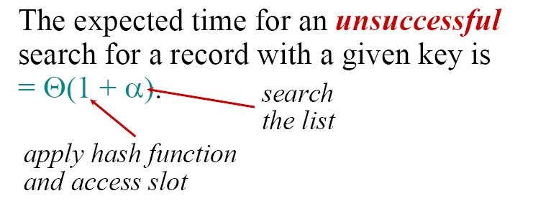
Search cost
The expected time for an unsuccessful
search for a record with a given key is
= Θ(1 + α) .
search
the list
apply hash function
and access slot

Slide 14
Search cost
The expected time for an unsuccessful
search for a record with a given key is
= Θ(1 + α) .
search
the list
apply hash function
and access slot
Expected search time = Θ(1) if α= O(1) ,
or equivalently, if n = O(m) .

Slide 15
Search cost
The expected time for an unsuccessful
search for a record with a given key is
= Θ(1 + α) .
search
the list
apply hash function
and access slot
Expected search time = Θ(1) if α= O(1) ,
or equivalently, if n = O(m) .
A successful search has same asymptotic
bound, but a rigorous argument is a little
more complicated. (See textbook.)

Slide 16
Choosing a hash function
The assumption of simple uniform hashing
is hard to guarantee, but several common
techniques tend to work well in practice as
long as their deficiencies can be avoided.
Desirata:
• A good hash function should distribute the
keys uniformly into the slots of the table.
• Regularity in the key distribution should
not affect this uniformity.

Slide 17
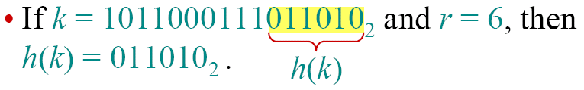
Division method
Assume all keys are integers, and define
h(k) = k mod m.
Deficiency: Don’t pick an m that has a small
remainder d. A preponderance of keys that are
congruent modulo d can adversely affect
uniformity.
Extreme deficiency: If m= 2^{r}, then the hash
doesn’t even depend on all the bits of k:
If
and
then

Slide 18
Division method (continued)
h(k) = k mod m.
Pick m to be a prime not too close to a power
of 2 or 10 and not otherwise used prominently
in the computing environment.
Annoyance:
• Sometimes, making the table size a prime is
inconvenient.
But, this method is popular, although the next
method we’ll see is usually superior.

Slide 19
Division method (continued)
Example
If n=2000, with 8-bit keys. The desired number of searched keys in an unsuccessful search is about 3.

Slide 20
Division method (continued)
Example
If n=2000, with 8-bit keys. The desired number of searched keys in an unsuccessful search is about 3.
m=701
Approximately =2000/3
A prime not close to any 2^{r}
h(k)=k mod 701

Slide 21
Multiplication method
Assume that all keys are integers, m= 2^{r}, and our
computer has w-bit words. Define
h(k) = (A·k mod 2^{w}) rsh (w–r),
where rsh is the “bitwise right-shift” operator and
A is an odd integer in the range 2^{w–1}< A< 2^{w}.
• Don’t pick A too close to 2^{w–1}or 2^{w}.
• Multiplication modulo 2^{w} is fast compared to
division.
• The rsh operator is fast.

Slide 22
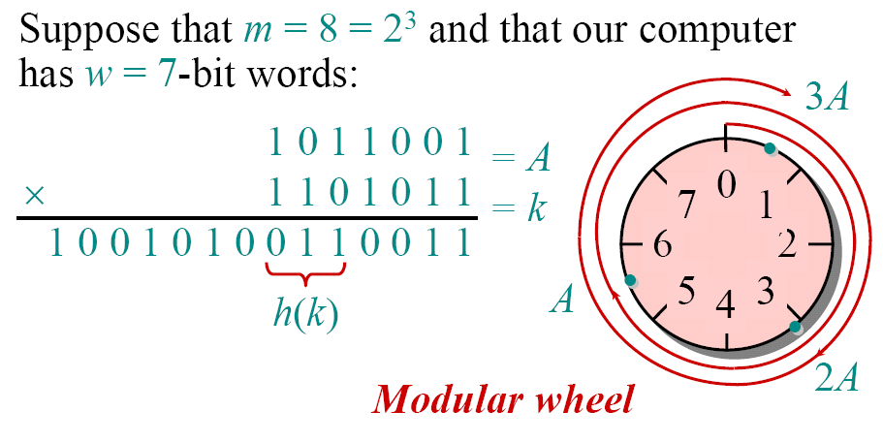
Multiplication method example
Suppose that m= 8 = 2³ and that our computer
has w= 7 -bit words:
Modular wheel

Slide 23
Resolving collisions by open addressing
No storage is used outside of the hash table itself.
Save pointers for a larger number of slots
• The hash function depends on both the key and
probe number:
h: U×{0, 1, …, m–1} →{0, 1, …, m–1}.
• The probe sequence <h(k,0), h(k,1), …, h(k,m–1)>
should be a permutation of {0, 1, …, m–1}.
• Insertion systematically probes the table until an
empty slot is found.

Slide 24
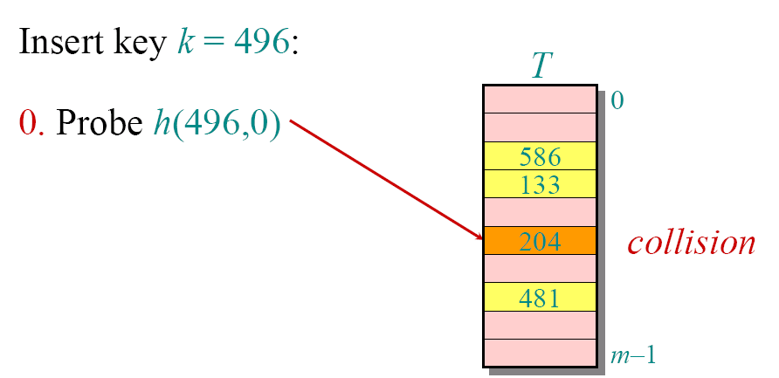
Example of open addressing
Insert key k= 496:
0.Probe h(496,0)
collision

Slide 25
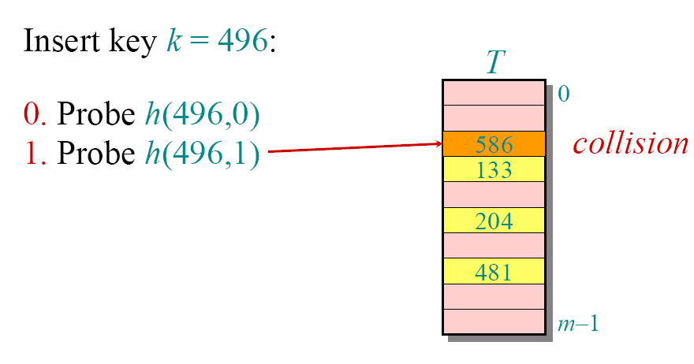
Example of open addressing
Insert key k= 496:
0. Probe h(496,0)
collision
1. Probe h(496,1)

Slide 26
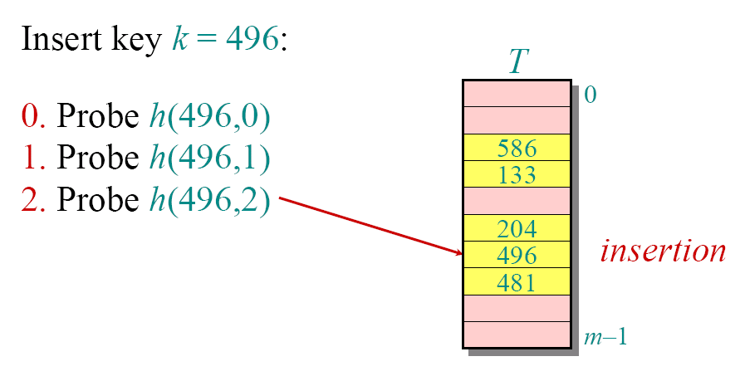
Example of open addressing
Insert key k= 496:
0. Probe h(496,0)
1. Probe h(496,1)
2. Probe h(496,2)
insertion

Slide 27
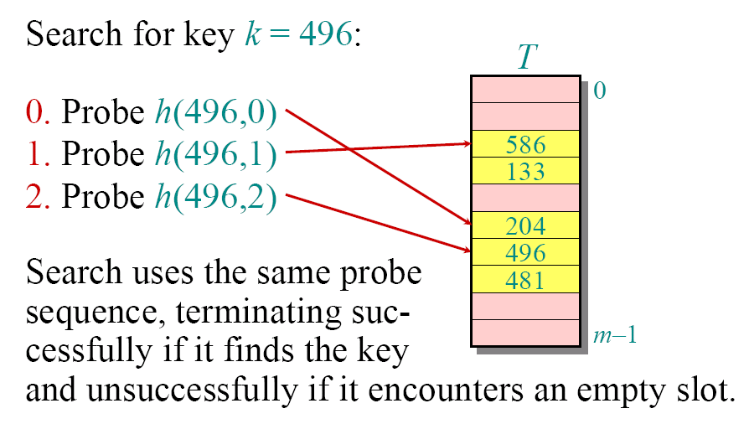
Example of open addressing
Search for key k= 496:
0. Probe h(496,0)
1. Probe h(496,1)
2. Probe h(496,2)
Search uses the same probe
sequence, terminating suc-
cessfully if it finds the key
and unsuccessfully if it encounters an empty slot.

Slide 28
Probing strategies
The assumption of uniform hashing:
Each key is equally likely to have any of the m! permutations of <0,1,…,m-1> as its probe sequence.
Probing functions:
Must guarantee the <h(k,0), h(k,1), …, h(k,m–1)> is a permutation of <0,1,…,m-1> for each key.
Try to fulfill the assumption of uniform hashing

Slide 29
Probing strategies
Linear probing:
Given an ordinary hash function h’(k), linear
probing uses the hash function
h(k,i) = (h’(k) +i) mod m.
This method, though simple, suffers from primary
clustering, where long runs of occupied slots build
up, increasing the average search time. Moreover,
the long runs of occupied slots tend to get longer.

Slide 30
Probing strategies
Quadratic probing:
Quadratic probing uses the hash function
h(k,i) = (h’(k) +c₁i+c₂i²) mod m.
Where h’(k) is an auxiliary hash function, c₁ and
c₂ ≠0 are auxiliary constants.
To make full use of the hash table, the values
of c₁ , c₂ , and m are constrained.
Much better than linear probing, still suffers
from a milder form of clustering, called
Secondary clustering.

Slide 31
Probing strategies
Double hashing:
Given two ordinary hash functions h₁(k)and h₂(k),
double hashing uses the hash function
h(k,i) = (h₁(k) +ih₂(k)) mod m.
This method generally produces excellent results,
but h₂(k) must be relatively prime to m. One way
is to make m a power of 2 and design h₂(k) to
produce only odd numbers.

Slide 32
Probing strategies
Linear probing
m different probe sequence
Quadratic probing
m different probe sequence
Double hash
m², close to the “ideal”

Slide 33
Analysis of open addressing
We make the assumption of uniform hashing:
• Each key is equally likely to have any one of
the m! permutations as its probe sequence.
Theorem. Given an open-addressed hash
table with load factor α= n/m< 1, the
expected number of probes in an
unsuccessful search is at most 1/(1–α).

Slide 34
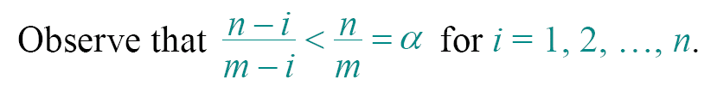
Proof of the theorem
Proof.
• At least one probe is always necessary.
• With probability n/m, the first probe hits an
occupied slot, and a second probe is necessary.
• With probability (n–1)/(m–1), the second probe
hits an occupied slot, and a third probe is
necessary.
• With probability (n–2)/(m–2), the third probe
hits an occupied slot, etc.

Slide 35
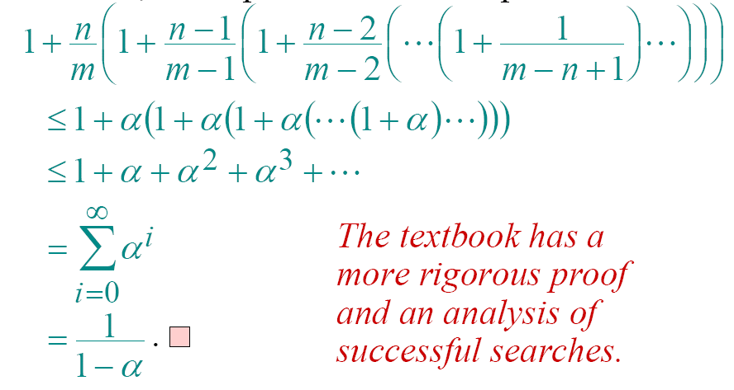
Proof (continued)
Therefore, the expected number of probes is
The textbook has a
more rigorous proof
and an analysis of
successful searches.

Slide 36
Analysis of open addressing
Corollary Inserting an element into an open-address hash table with load factor α requires at most 1/(1–α) probes on average, assuming uniform hashing.

Slide 37
Implications of the theorem
• If α is constant, then accessing an open-
addressed hash table takes constant time.
• If the table is half full, then the expected
number of probes is 1/(1–0.5) = 2.
• If the table is 90% full, then the expected
number of probes is 1/(1–0.9) = 10.

Slide 38
Consider using open addressing to insert keys 10, 22, 31, 4, 15, 28, 17, 88, 59 into a hash table of length m=11, the auxiliary hash function is h'(k)=k. The procedure of inserting these keys into the hash table using linear probe is shown as follows.

Slide 39
Consider using open addressing to insert keys 10, 22, 31, 4, 15, 28, 17, 88, 59 into a hash table of length m=11, the auxiliary hash function is h'(k)=k. The procedure of inserting these keys into the hash table using linear probe is shown as follows.
h(10,0)=10
 |  |  |  |  |  |  |  |  |  | 10
h(22,0)=0
22 |  |  |  |  |  |  |  |  |  | 10
h(31,0)=9
22 |  |  |  |  |  |  |  |  | 31 | 10
h(4,0)=4
22 |  |  |  | 4 |  |  |  |  | 31 | 10
h(15,0)=4
conflict!
22 |  |  |  | 4 |  |  |  |  | 31 | 10
h(15,1)=5
22 |  |  |  | 4 | 15 |  |  |  | 31 | 10

Slide 40
Consider using open addressing to insert keys 10, 22, 31, 4, 15, 28, 17, 88, 59 into a hash table of length m=11, the auxiliary hash function is h'(k)=k. The procedure of inserting these keys into the hash table using linear probe is shown as follows.
h(28,0)=6
22 |  |  |  | 4 | 15 | 28 |  |  | 31 | 10
h(17,0)=6
conflict！
22 |  |  |  | 4 | 15 | 28 |  |  | 31 | 10
h(17,1)=7
22 |  |  |  | 4 | 15 | 28 | 17 |  | 31 | 10
h(88,0)=0
conflict！
22 |  |  |  | 4 | 15 | 28 | 17 |  | 31 | 10
h(88,1)=1
22 | 88 |  |  | 4 | 15 | 28 | 17 |  | 31 | 10
h(59,0)=4
conflict！
22 | 88 |  |  | 4 | 15 | 28 | 17 |  | 31 | 10
h(59,1)=5
conflict！
22 | 88 |  |  | 4 | 15 | 28 | 17 |  | 31 | 10

Slide 41
Consider using open addressing to insert keys 10, 22, 31, 4, 15, 28, 17, 88, 59 into a hash table of length m=11, the auxiliary hash function is h'(k)=k. The procedure of inserting these keys into the hash table using linear probe is shown as follows.
h(59,2)=6
conflict！
22 | 88 |  |  | 4 | 15 | 28 | 17 |  | 31 | 10
h(59,3)=7
conflict！
22 | 88 |  |  | 4 | 15 | 28 | 17 |  | 31 | 10
h(59,4)=8
22 | 88 |  |  | 4 | 15 | 28 | 17 | 59 | 31 | 10

